Slide 1
Stranger in a Strange Land: Automated Vehicles on Human-Centric Roads (AAAI’2017)
Hilton San Francisco| February 4, 2017

Slide 2
Why Connected-Automated Vehicles?

Slide 3
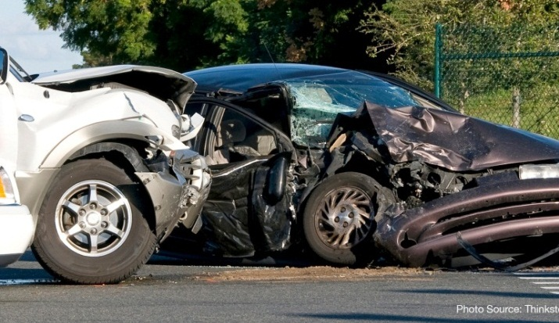
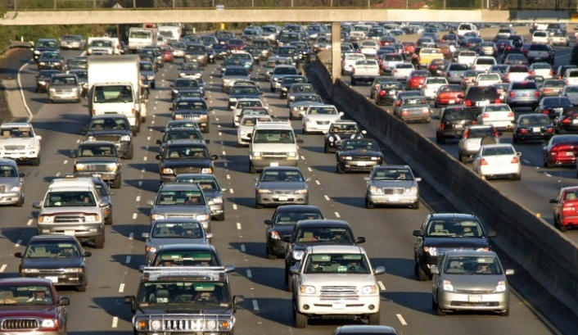
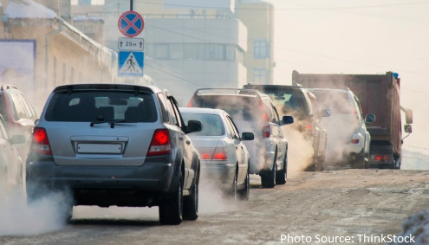
The Scale of the Problem
Safety
35,092 highway deaths in 2015¹
6.3 million crashes in 2015¹
A leading cause of death for ages 1-44²
Data Sources: ¹DOT HS 812 318, Traffic Safety Facts, National Highway Traffic Safety Administration (August 2016)
²10 Leading Causes of Death by Age Group, United States – 2014, Centers for Disease Control and Prevention
³2015 Urban Mobility Scorecard, Texas A&M Transportation Institute and INRIX (August 2015)
Mobility³
6.9 billion hours of travel delay
$160 billion cost of urban congestion
Environment³
3.1 billion gallons of wasted fuel
60 billion lbs of additional CO₂

Slide 4
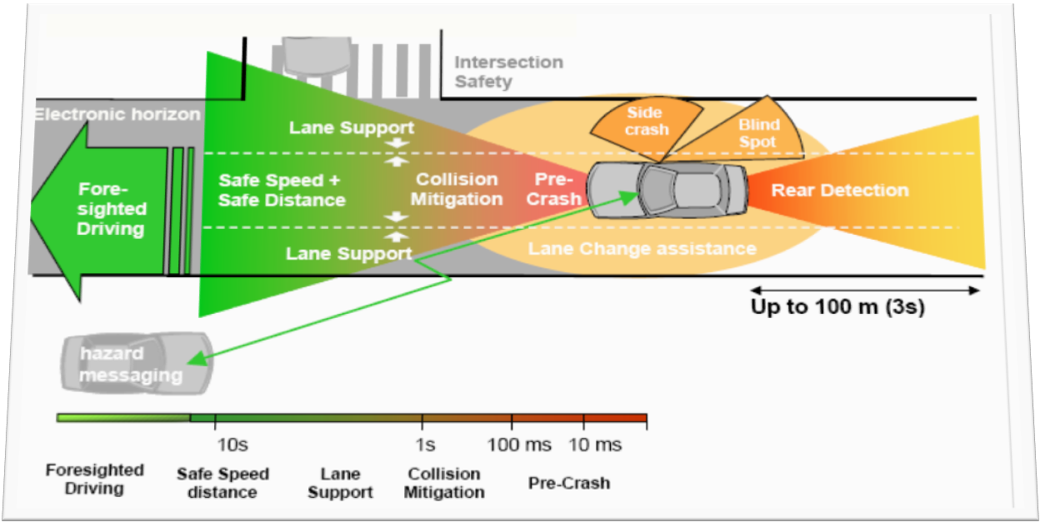
The Opportunity

Slide 5
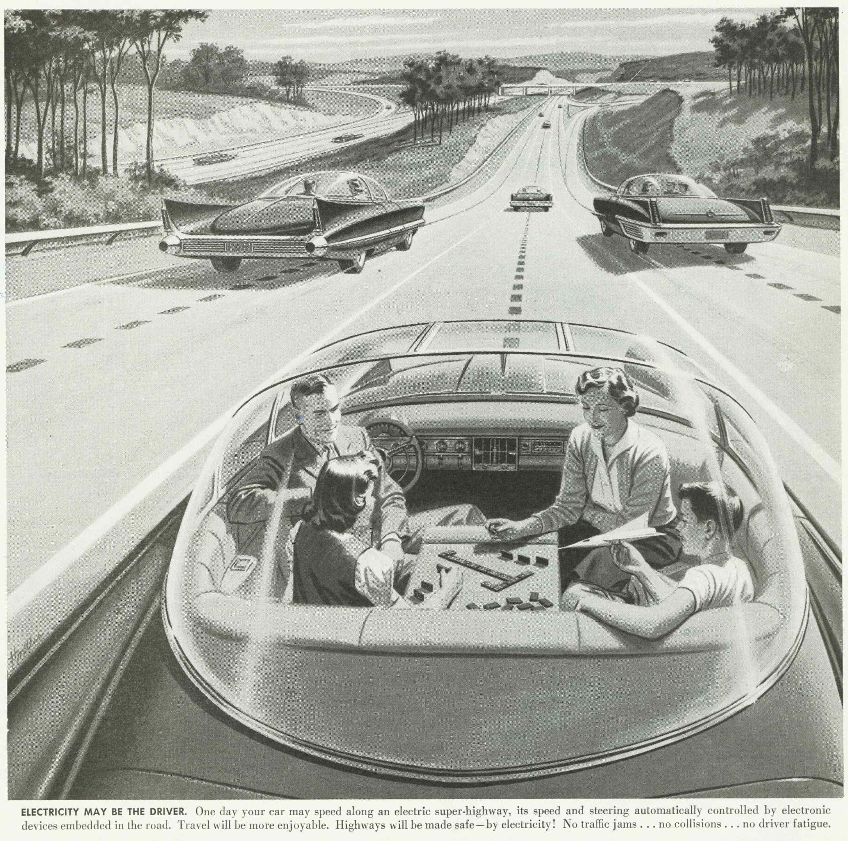
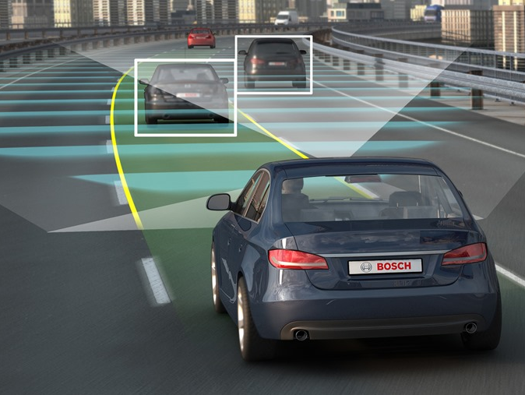
Why Now?

Slide 6
The Challenge
Intelligent vehicles cannot achieve human levels of performance until machine vision systems achieve human levels of performance (James Albus, 2009)
Measure of human performance in 2015, in the U.S.:
500,000 miles driven between crashes (approximately 1.9 years)
1.8 million miles driven between injury crashes
98 million miles driven between fatal crashes (approximately 370 years of operation between extreme failures)

Slide 7
Automated Vehicles: An Introduction
Overview

Slide 8
Automated vehicles are…
Here Today
Coming Soon
Just Hype

Slide 9
Automated vehicles are…
Here Today
Coming Soon
Just Hype
All of the Above

Slide 10
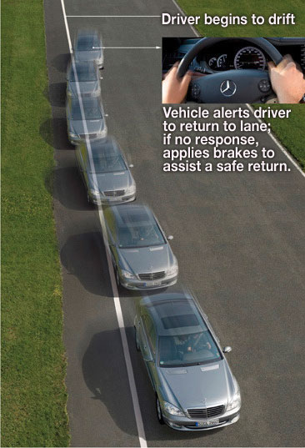
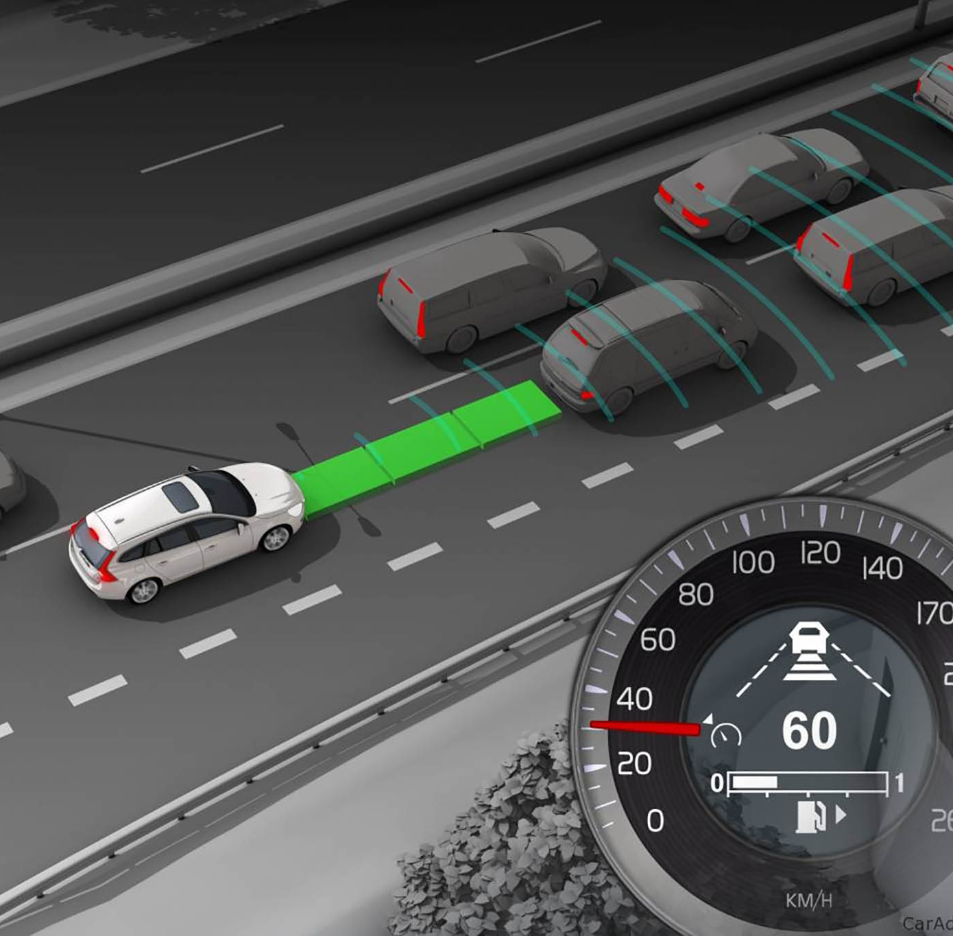
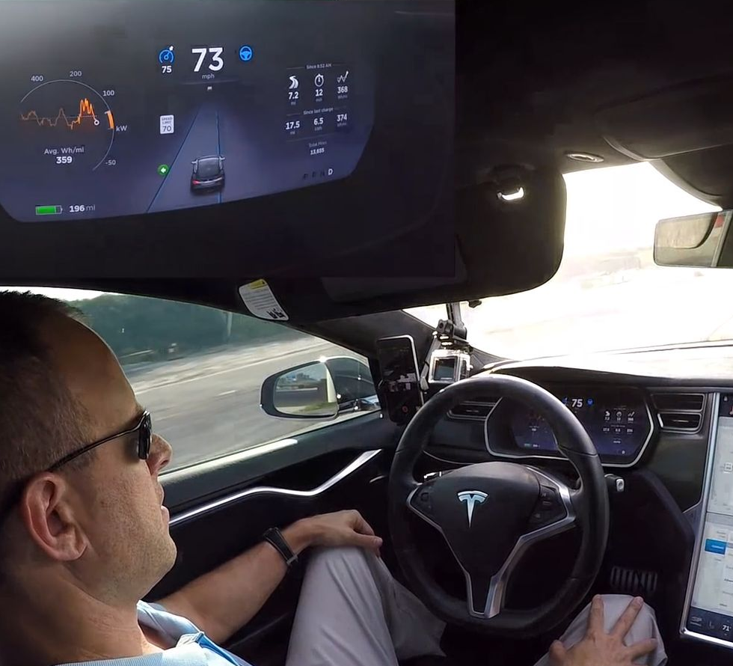
Automated vehicles are here…today
Most major manufacturers currently offer Level 1 systems (e.g., lane keep assist, adaptive cruise control); some offer Level 2 systems (e.g., Tesla Autopilot, Audi Traffic Jam Assist).
Notes:
LKA: http://blog.truecar.com/wp-content/uploads/2010/10/Mercedes-Benz-lane-keeping-assist.jpg
ACC: http://aw-wordpress-dev.s3-us-west-2.amazonaws.com/wp-content/uploads/2015/07/Autoweb-2015-July-Guide-Adaptive-Cruise-Control-006.jpg
Tesla AP: https://cdn0.vox-cdn.com/thumbor/LBhxgwBkkQzOF-uLtgGkbpIXfSo=/0x0:1920x1080/1600x900/cdn0.vox-cdn.com/uploads/chorus_image/image/49681973/VRG_VUP_285_tesla-autopilot-mishaps_SITE.00_00_43_13.Still003.0.0.jpg

Slide 11
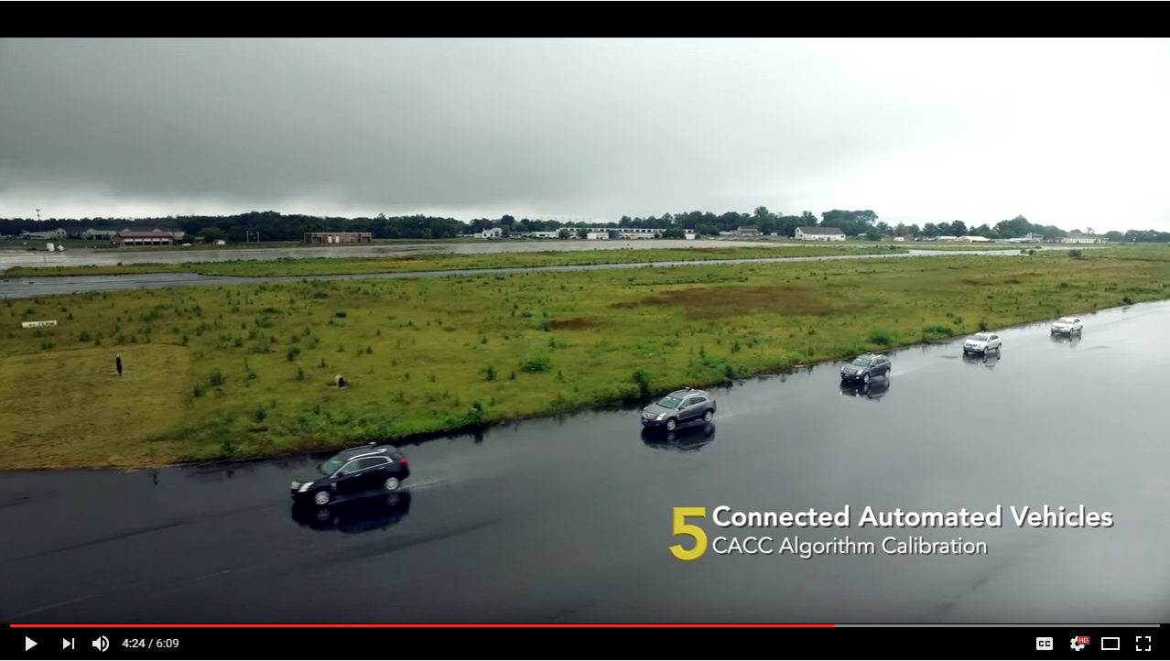
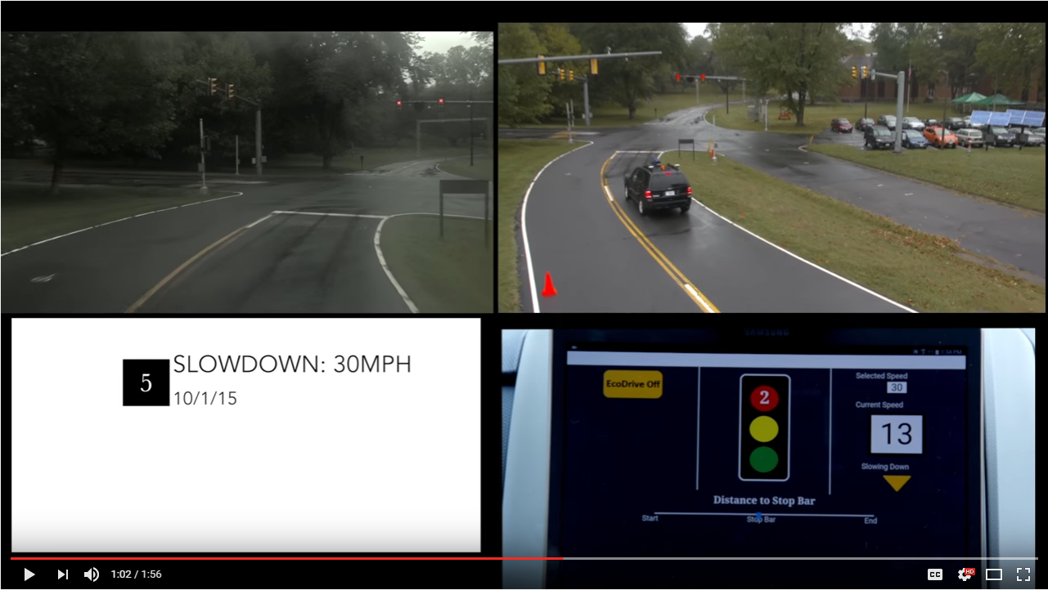
Automated vehicles are here… today
FHWA has been funding research into connected Level 1 applications, including cooperative adaptive cruise control (CACC), GlidePath, Connected/Automated Truck Platooning, and Lane Change/Merge.

Slide 12
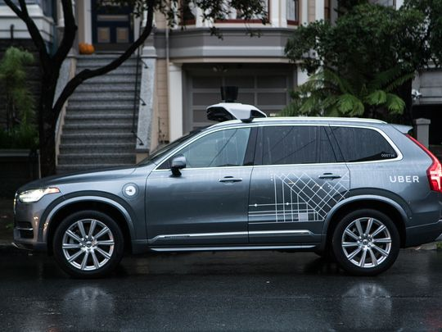
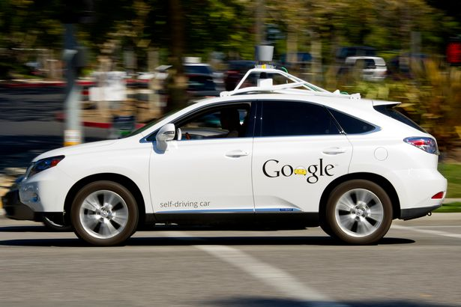
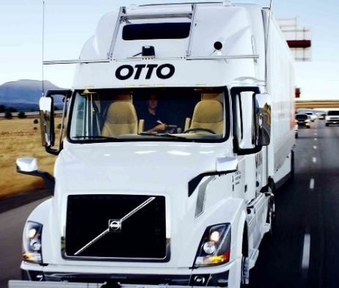
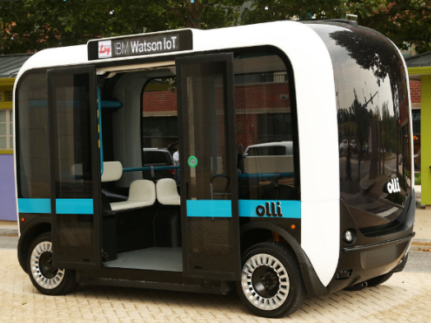
Automated vehicles are here… today
Dozens of manufacturers and technology companies are currently testing in several states, including California, Florida, Massachusetts, Michigan, Nevada, and Pennsylvania. They are not only testing passenger vehicles, but heavy duty commercial and small transit-like vehicles too.
Notes:
Uber: http://www.usatoday.com/story/tech/news/2016/12/14/ubers-self-driving-volvos-picking-up-sf-riders/95395838/
Google: http://www.mirror.co.uk/tech/google-paying-people-test-drive-7963364
Otto: https://www.wired.com/2016/10/ubers-self-driving-truck-makes-first-delivery-50000-beers/
Local Motors: http://www.digitaltrends.com/cars/olli-autonomous-car-powered-by-ibm-watson-local-motors/

Slide 13
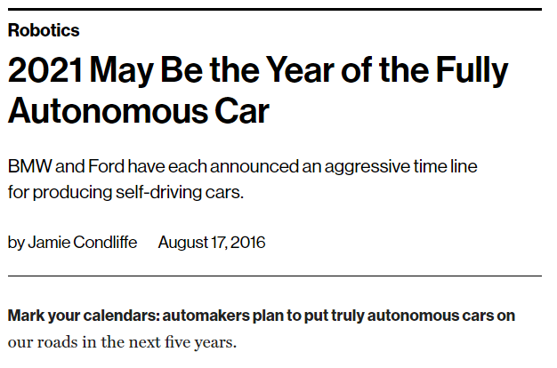
Automated vehicles are…coming soon
Many manufacturers are targeting 2020 (or potentially sooner) to introduce Level 3 and 4 automated vehicles...

Slide 14
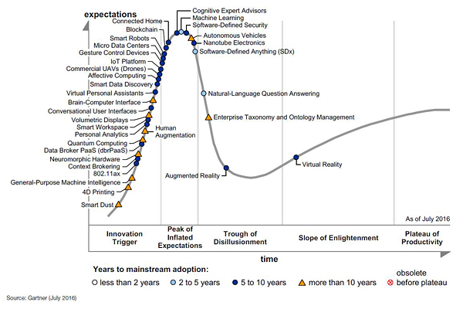
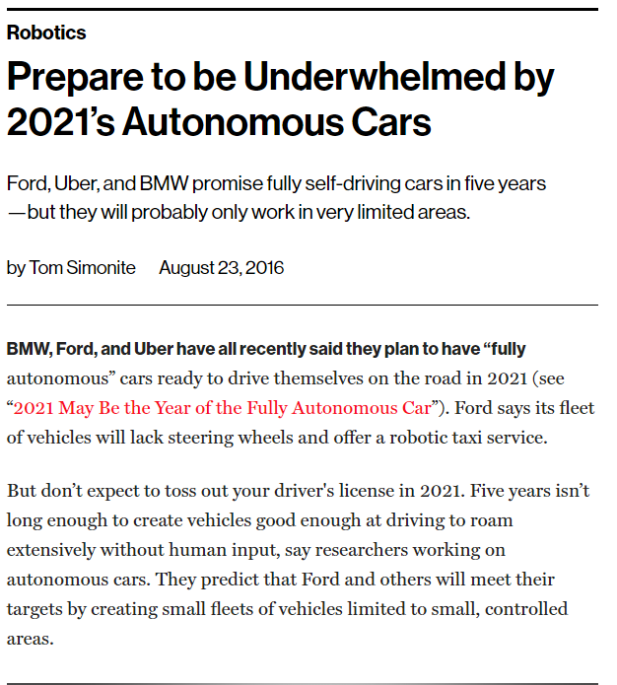
Automated vehicles are…just hype
Source: Gartner (August 2016)
…though their initial functionality/availability may be more limited than current hype suggests.
Notes:
Images: “Hype Cycle for Emerging Technologies” from Gartner (August 2015 and August 2016)

Slide 15
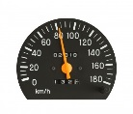
A brief introduction to SAE J3016
SAE Level | SAE Name | Definition | Automation Controls… | Example(s)
0 | No Automation | Human performs entire driving task | __
1 | Driver Assistance | Automation controls one vehicle function (steering OR speed) |  | Adaptive Cruise Control Lane Keep Assist
2 | Partial Automation | Automation controls BOTH steering and speed; driver responsible for monitoring and immediate reengagement |  | Tesla Autopilot Audi Traffic Jam Assistant
3 | Conditional Automation | Automation controls BOTH steering and speed and monitors environment; driver may be notified to reengage |  | Volvo DriveMe
4 | High Automation | Automation performs all aspects of dynamic driving task in SOME driving modes; driver not required to reengage |  | Closed Campus Driverless Shuttle Driverless Valet
5 | Full Automation | Automation performs all aspects of dynamic driving task under ALL roadway and environmental conditions |  | Driverless Taxi
OR
AND

Slide 16
How will Automated Vehicles Interact with the Nation’s Road System?

Slide 17
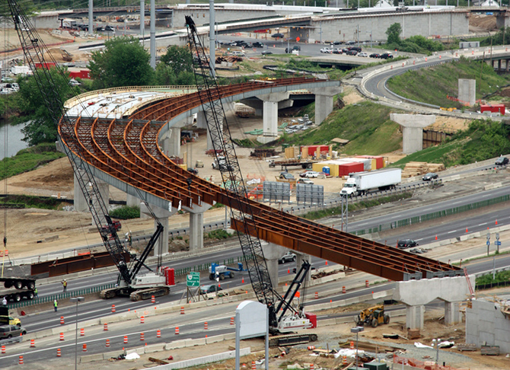
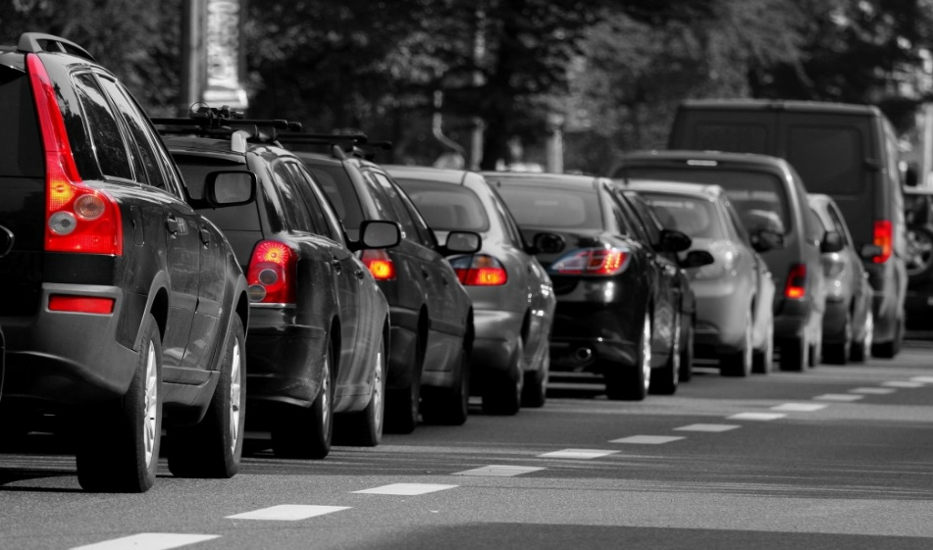
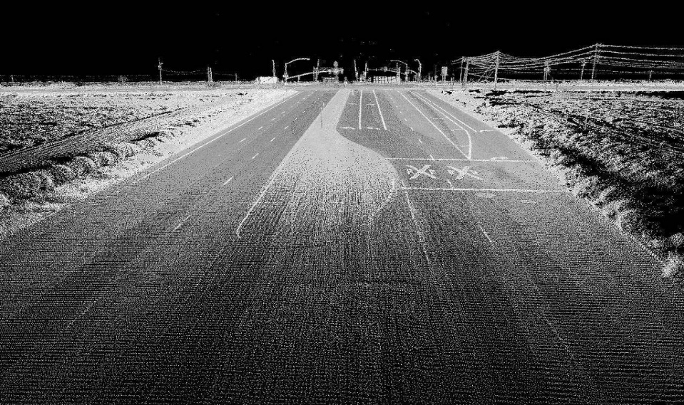
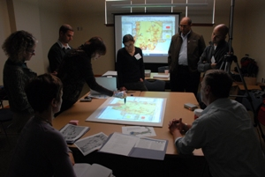
Many potential impacts to road operators roles, responsibilities, and activities
Physical Infrastructure
Roadway Operations
Digital Infrastructure
Programs and Practices
NEW
Notes:
1: http://usa.streetsblog.org/wp-content/uploads/sites/5/2013/03/highway-construction.jpg
2: https://www.transportation.gov/sites/dot.gov/files/docs/congested-traffic.jpg
3: https://c1.staticflickr.com/9/8514/8554902851_894e7aaa7e_b.jpg (Oregon State University)
4: https://www.volpe.dot.gov/sites/volpe.dot.gov/files/capecod5_interag.jpg

Slide 18
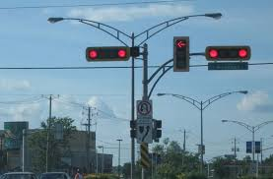
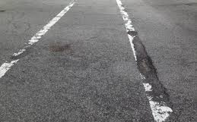
Physical Infrastructure Implications
Physical Infrastructure
Unclear infrastructure requirements for AVs (signs, signals, markings)
Possible need for adaptations to design standards, greater consistency
Implications for maintenance and investment
Roadway Operations
Digital Infrastructure
Programs and Practices

Slide 19
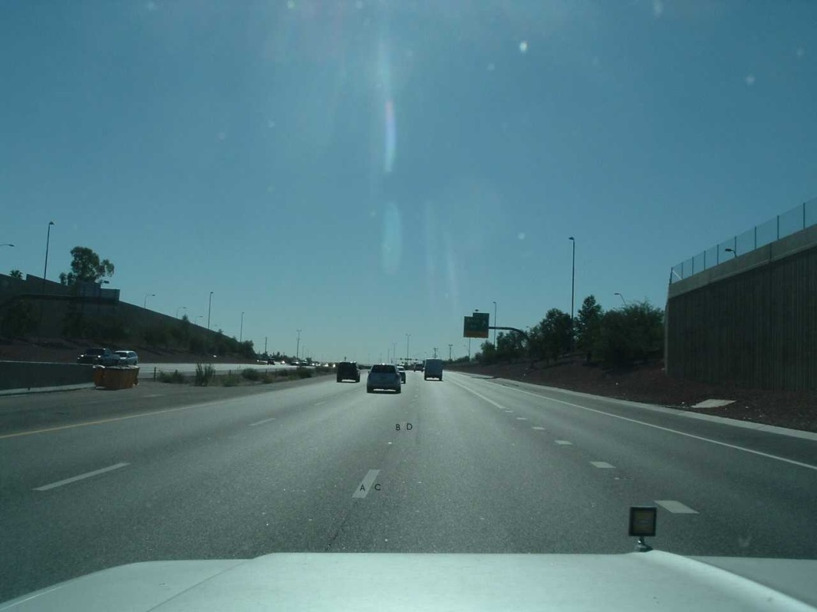
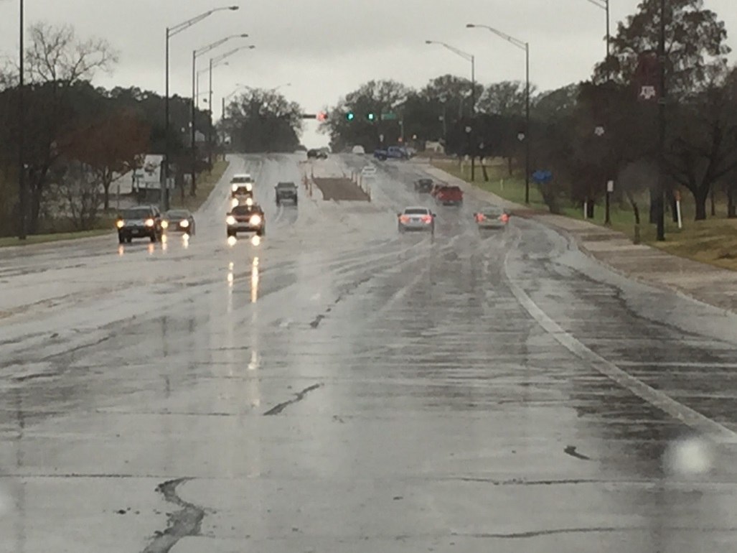
Physical Infrastructure Challenges

Slide 20
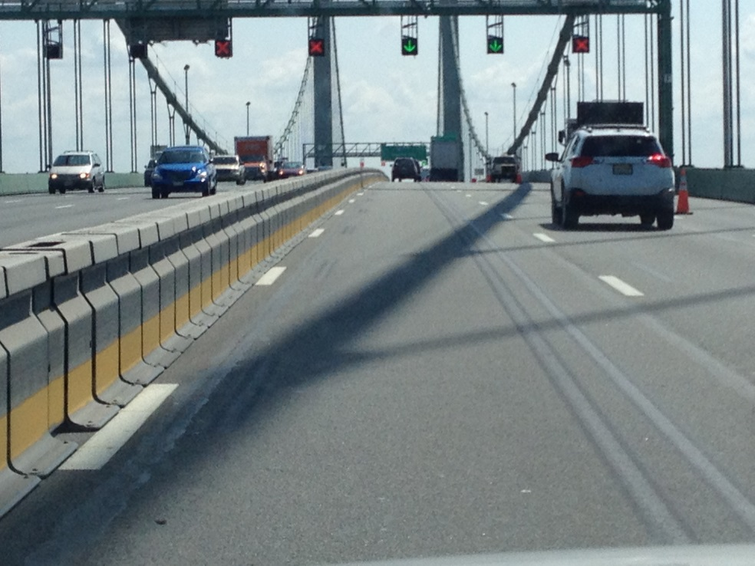
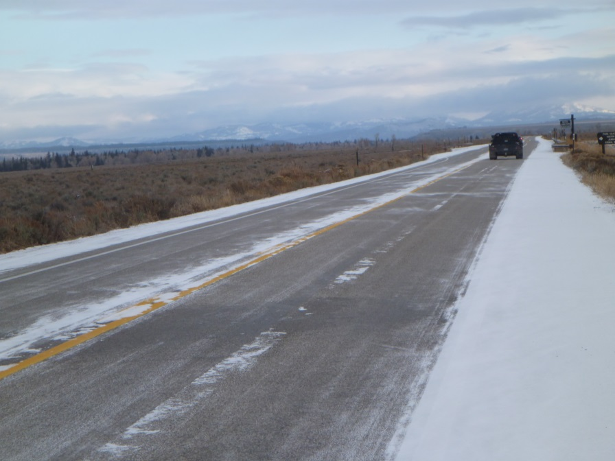
Physical Infrastructure Challenges

Slide 21
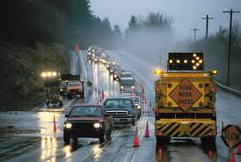
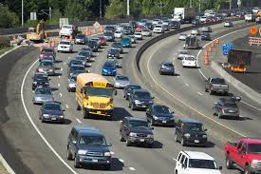
Roadway Operations Challenges
Physical Infrastructure
Challenges of managing a mixed traffic environment (AVs, CVs, non-AVs, CAVs)
New challenges in harmonizing traffic flow
Potential travel demand changes
Potential long-term efficiency, congestion benefits
Roadway Operations
Digital Infrastructure
Programs and Practices

Slide 22
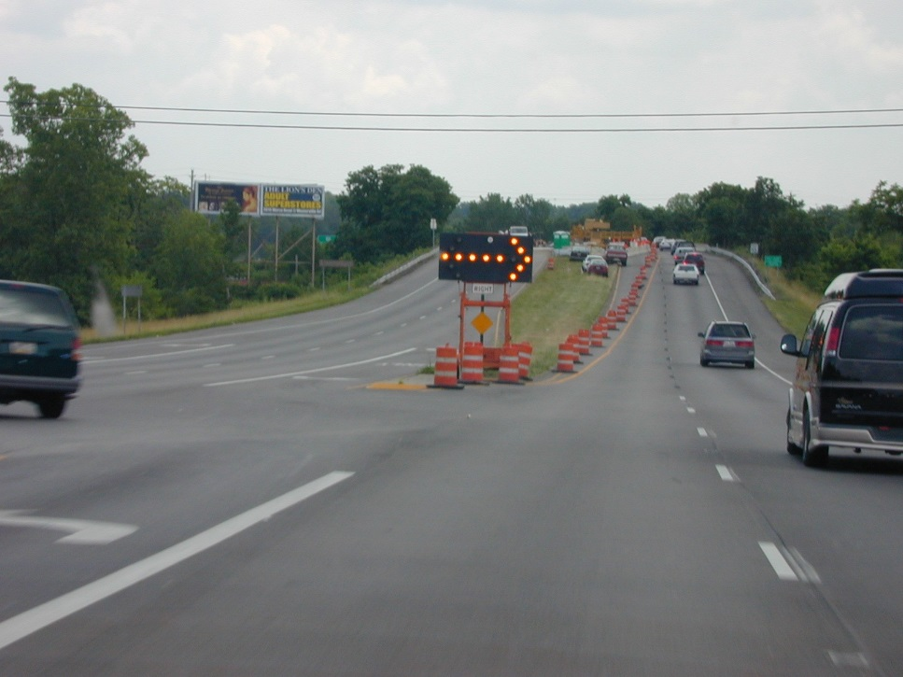
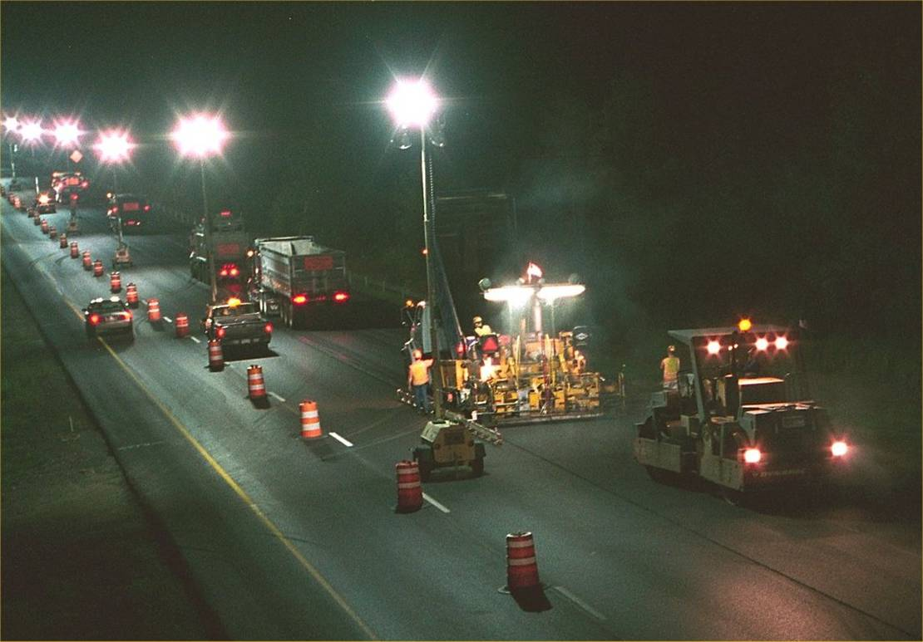
Roadway Operations Challenges - Workzones

Slide 23
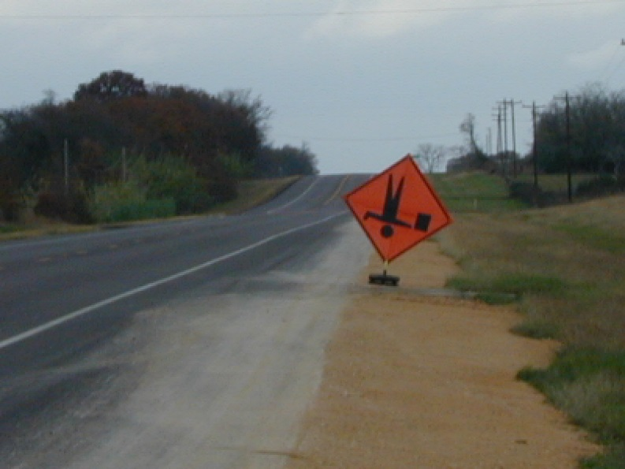
Roadway Operations Challenges - Workzones

Slide 24
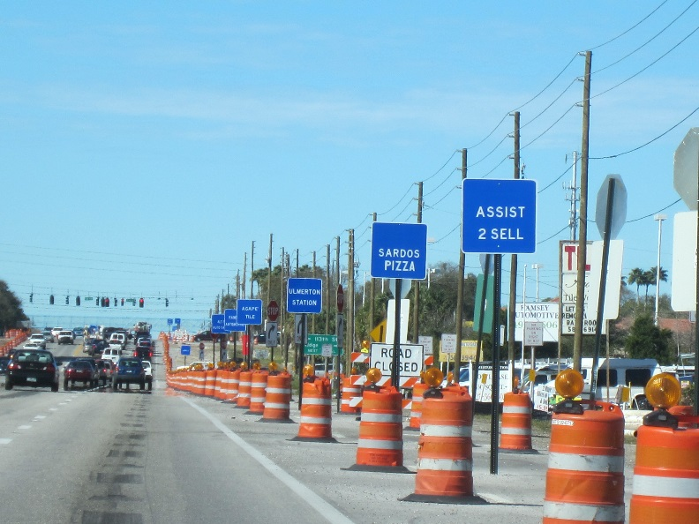
Roadway Operations Challenges - Workzones

Slide 25
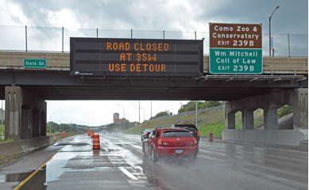
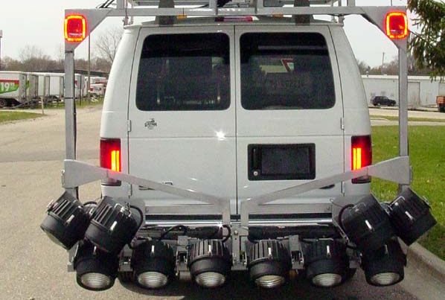
Digital Infrastructure Considerations
Physical Infrastructure
AVs as new sources of roadway data
Data updates on construction and road closures
Maintenance of digital infrastructure
Roadway Operations
Digital Infrastructure
Programs and Practices

Slide 26
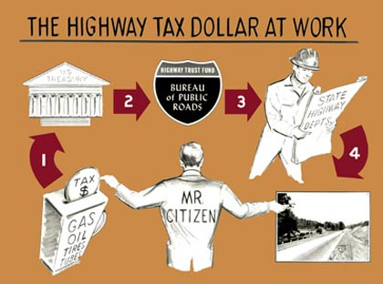
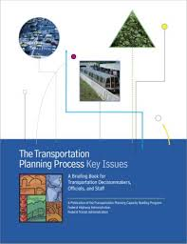
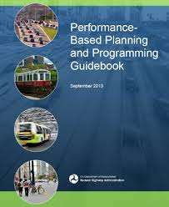
Programs and Practices
Physical Infrastructure
Accounting for AVs and potential land use impacts and uncertainty in long range planning process
Implications of shared vehicle fleets and new mobility models on travel demand modeling/forecasting
Revenue and budget implications
Roadway Operations
Digital Infrastructure
Programs and Practices

Slide 27
Connected Vehicles: An Introduction
Overview

Slide 28
Connected Vehicle Technology
5.9GHz DSRC (Dedicated Short Range Communications) + GNSS
802.11p technology similar to 802.11a
Low latency communication (<< 50ms)
High data transfer rates (6 – 27 Mbps)
Line-of-sight, point-point communication range of up to 1000m
Coverage over 360°
Multi-hopping possible for extended range
7 channels support a wide range of safety and non-safety applications

Slide 29
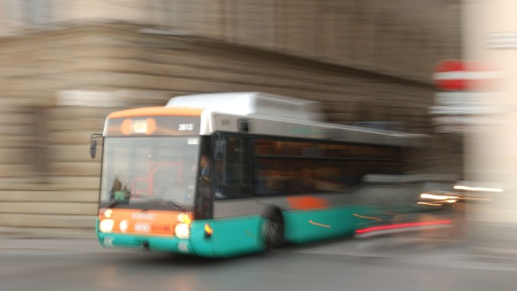
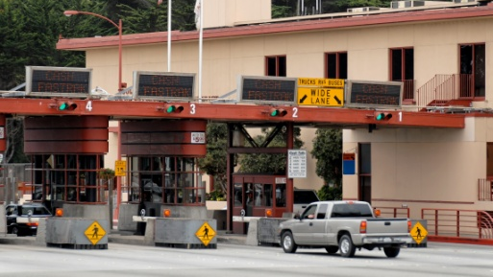
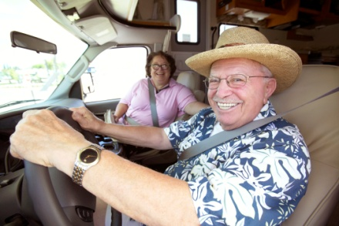
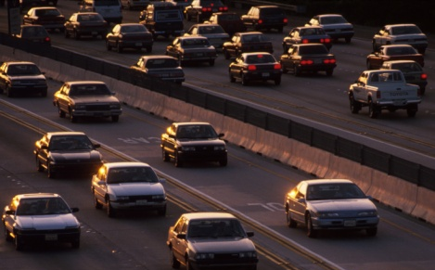
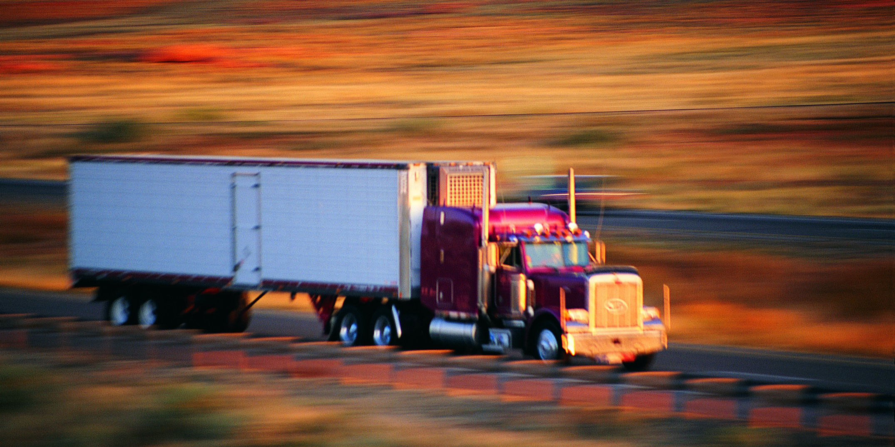
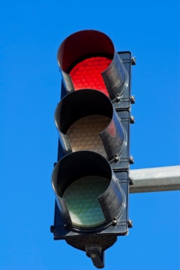
Connected vehicles includes…
Drivers/Operators
Image Source: Thinkstock
Image Source: Thinkstock
Vehicles and Fleets
Infrastructure
Image Source: Thinkstock
Image Source: Thinkstock
Image Source: Thinkstock
Image Source: Thinkstock
Wireless Devices

Slide 30
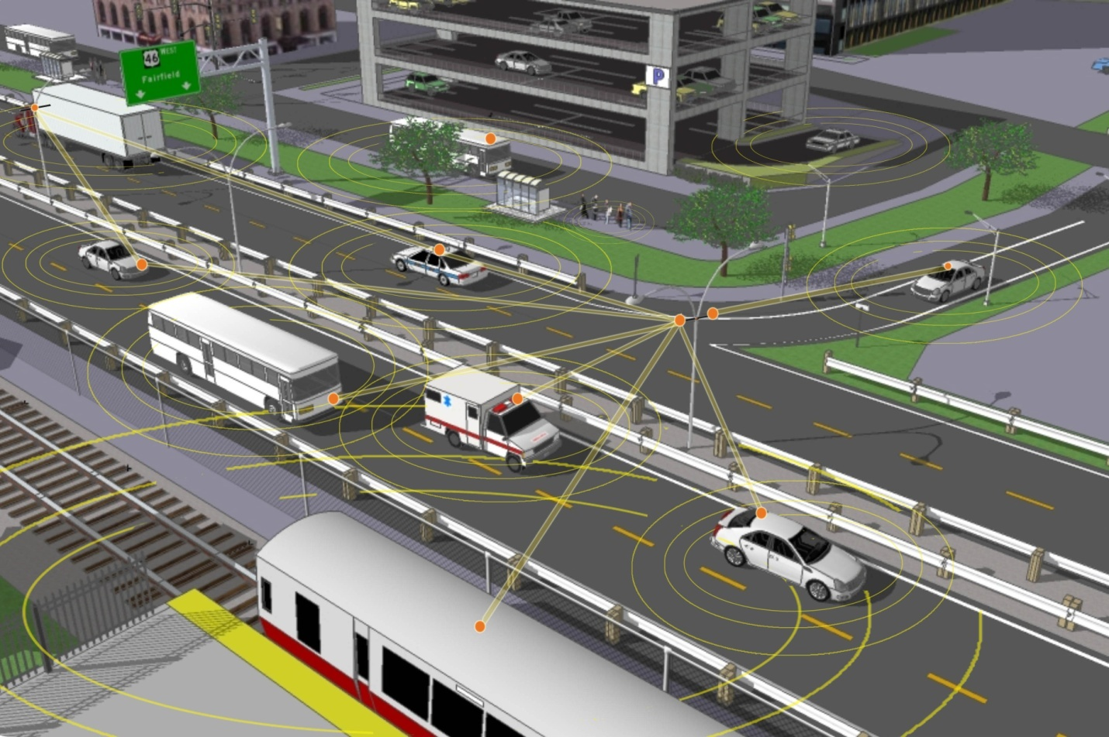
Infrastructure Messages
Signal Phase and Timing,
Fog Ahead
Train Coming
Drive 35 mph
50 Parking Spaces Available
Vehicle Data
latitude, longitude, time, heading angle, speed, lateral acceleration, longitudinal acceleration, yaw rate, throttle position, brake status, steering angle, headlight status, wiper status, external temperature, turn signal status, vehicle length, vehicle width, vehicle mass, bumper height

Slide 31
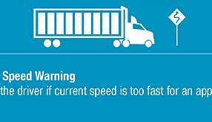
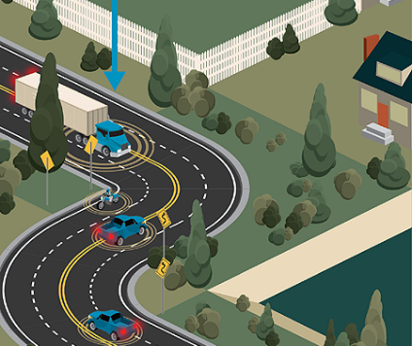
Curve Speed Warning
Curve Speed Warning
Alerts the driver if current speed is too fast for an approaching curve
Target crashes approaching horizontal curves on segments or interchange ramps that are speed-related
Alert cars and trucks they are entering a curve at too high a speed to negotiate it safely
Improve:
Reduction in truck rollover and in road departure crashes
Notes:
Curve speed warning (CSW) is a V2I application that warns drivers when they are approaching or entering a curve at too high of a speed to negotiate it safely. CSW relies on roadside equipment and is therefore only available at designated locations.

Slide 32
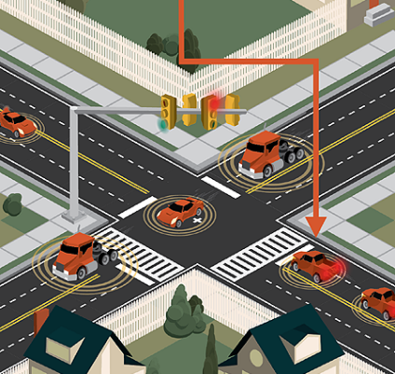
Red Light Violation Warning
Red Light Violation Warning
Issues warning to the driver if he/she is about to run a red light
Target crashes that result from signal violations
Wireless exchange of critical safety and operational data
Reduce the frequency and severity of safety-related incidents
Improves:
Significant reduction in collisions, injuries, and fatalities at intersections
Non-recurring congestion resulting from incidents is reduced
Notes:
Another early application is the red light violation warning.
The red light violation warning issues a warning to a driver who is about to run a red light.
Note that V2I safety applications are vehicle-based. That is, the infrastructure provides data that are processed on the vehicle to determine if an alert or warning should be provided to the driver.
See more at: http://www.its.dot.gov/infographs/red_light_violation.htm#sthash.0VUKOOi7.dpuf

Slide 33
Eco-Signal Operations Overview
Use connected vehicle technologies to: reduce idling, number of stops, unnecessary accelerations/decelerations, and improve traffic flow to decrease fuel consumption and emissions.
Combined Modeling of Applications:
Resulted in a 9.6% reduction in fuel consumption.
Roadside
Equipment (RSE) Unit
Traffic Signal Controller
Automated Longitudinal Control using V2V Communications
Source: USDOT, July 2013
Notes:
Eco-signal operations applications use connected vehicle technologies to decrease fuel consumption and emissions by reducing idling, the number of stops, unnecessary accelerations/decelerations, and improving traffic flow at signalized intersections.
These applications, located in a vehicle, collect SPaT and geographic information description messages using V2I communications and data from nearby vehicles using V2V communications.
Upon receiving these messages, the application performs calculations to determine the vehicle’s optimal speed to pass the next traffic signal on a green light or to decelerate to a stop in the most eco-friendly manner.
This information is provided to the driver via a driver vehicle interface (DVI) or sent to longitudinal vehicle control capabilities in the vehicle to support partial automation.
Potential benefits for applications in this bundle include:
Eco-Approach and Departure at Signalized Intersections: Provides 5% to 10% fuel reduction benefits.
Eco-Traffic Signal Timing: Provides up to 5% improvement in fuel consumption and environmental measures at full connected vehicle penetration.
Eco-Traffic Signal Priority: Provides 2–4% fuel reduction benefits, resulting in approximately $650,000 savings per year for a transit or truck fleet of 1,000 vehicles.
Combined Modeling of the Eco-Signal Operations Applications: Resulted in a 9.6% reduction in fuel consumption.

Slide 34
Mobility and the Environment
Photo source: Thinkstock
Photo source: Thinkstock

Slide 35
Vision for CAV
Autonomous Vehicle
Operates in isolation from other vehicles using internal sensors.
Connected Automated Vehicle
Leverages automated and
connected vehicle technologies.
Connected Vehicle
Communicates with nearby
vehicles and infrastructure.
Not automated (level 0)

Slide 36
Resources
Federal Automated Vehicles Policy https://www.transportation.gov/AV/federal-automated-vehicles-policy-september-2016
U.S. DOT Intelligent Transportation Systems Joint Program Office http://its.dot.gov
Governors Highway Safety Association (GHSA) GHSA Autonomous Vehicle Report http://www.ghsa.org/resources/spotlight-av17
American Association of Motor Vehicle Administrators (AAMVA) Autonomous Vehicle Information Library http://www.aamva.org/autonomous-vehicle-information-library/
Automated Vehicle Symposium 2017 Hilton San Francisco Union Square, July 11-13, 2017 http://www.automatedvehiclessymposium.org/home

Slide 37
Questions? Carl K. Andersen carl.andersen@dot.gov +1 (202) 493-3045

